Slide 1
Domain trust framework
Jorge Fonseca (he/him)
Senior Solutions Architect
Amazon Web Services
Notes:
Welcome to the AWS Unlocking the potential of IoT in Travel and Hospitality Session. I’m SriHari Thotapalli, Principal Solutions Architect for AWS Travel & Hospitality. We are grateful that you’re able to join us today.
Abstract: Travel and hospitality companies looking to meet customer expectations and differentiate themselves from their competitors are turning to the Internet of Things (IoT). In this session, you will learn how early adopters are using IoT to develop connected kitchen and hotel room experiences, implement airline bag tracking solutions and aircraft turn tracking solutions, and more. Discover how you can take advantage of the latest IoT advancements to improve your business outcomes.

Slide 2

The book
2016
3 decades since the birth of the internet
tech forces that will shape the next 30 years

Slide 3
The forces
Becoming
Cognifying
Flowing
Screening
Accessing
Sharing
Filtering
Remixing
Interacting
Tracking
Questioning
Beginning
What’s taking us so long?
🤔

Slide 4

Becoming
Cognifying
Flowing
Screening
Accessing
Sharing
Filtering
Remixing
Interacting
Tracking
Questioning
Beginning
Becoming
Vision: all things will upgrade via internet
Reality: software yes, ⚠️ few things are connected
Blockers: Wi-Fi (user config), 2G/5G (cost)
Tap to connect?
🤔

Slide 5

Becoming
Cognifying
Flowing
Screening
Accessing
Sharing
Filtering
Remixing
Interacting
Tracking
Questioning
Beginning
Cognifying
Vision: A.I. will cognify objects, making them intelligent
Reality: smart things, ⚠️ most home appliances still dumb
Blockers: connectivity, interactive UX, personalized info
Tap to cognify?
🤔

Slide 6

Becoming
Cognifying
Flowing
Screening
Accessing
Sharing
Filtering
Remixing
Interacting
Tracking
Questioning
Beginning
Flowing
Vision: we’ll depend on unstoppable streams
Reality: social networks, streaming, real-time banking
Blockers: ad revenue driven, spam, right to be forgotten
Check-in and interact,
check-out and forget?
🤔

Slide 7

Becoming
Cognifying
Flowing
Screening
Accessing
Sharing
Filtering
Remixing
Interacting
Tracking
Questioning
Beginning
Screening
Vision: screens will be in every object, adapting to users
Reality: 6.8B smartphones, 86% of global population
Blockers: app UX is hard, screens in objects is hard
Tap/scan to activate the UI/UX
of all things/services on my phone
🤔

Slide 8

Becoming
Cognifying
Flowing
Screening
Accessing
Sharing
Filtering
Remixing
Interacting
Tracking
Questioning
Beginning
Accessing
Vision: we’ll use when needed, instead of owning
Reality: video/music streaming, cloud compute
Blockers: hard to UX, install apps, register, vendor lock-in
Instantly share my info/credentials
with any object/place/service?
🤔

Slide 9

Becoming
Cognifying
Flowing
Screening
Accessing
Sharing
Filtering
Remixing
Interacting
Tracking
Questioning
Beginning
Sharing
Vision: we’ll share everything
Reality: social, work, videos, tap to pay, ⚠️ covid certs
Blockers: open protocols, data residency, global DB, trust
Global, distributed, open framework
for users to authorise disclosure
between trusted service providers?
🤔

Slide 10

Becoming
Cognifying
Flowing
Screening
Accessing
Sharing
Filtering
Remixing
Interacting
Tracking
Questioning
Beginning
Filtering
Vision: we’ll customize/personalize, anticipate experiences
Reality: media, shopping, ⚠️ average, not unique
Blockers: we’re guessing, instead of asking
Tap to instantly share my profile,
seat preferences, food allergies,
or favourite movies?
🤔

Slide 11

Becoming
Cognifying
Flowing
Screening
Accessing
Sharing
Filtering
Remixing
Interacting
Tracking
Questioning
Beginning
Remixing
Vision: we’ll combine primitive parts into new data flows
Reality: app OS, cloud building blocks, ⚠️ tax return forms
Blockers: low accessing (integration), low sharing
Companies compose UX flows
with user’s shares and UI inputs?
🤔

Slide 12

Becoming
Cognifying
Flowing
Screening
Accessing
Sharing
Filtering
Remixing
Interacting
Tracking
Questioning
Beginning
Interacting
Vision: anything not interactive will be considered broken
Reality: children touch things in museums as if tables
Blockers: low screening, low cognifying
Companies ship physical products
that come to life with a tap/scan?
🤔

Slide 13

Becoming
Cognifying
Flowing
Screening
Accessing
Sharing
Filtering
Remixing
Interacting
Tracking
Questioning
Beginning
Tracking
Vision: every activity will be recorded, for user’s benefit
Reality: fit tracker, map timeline, points programs, ⚠️ silos
Blockers: time/scope limit, be forgotten, GDPR, sharing
Show my hand to cross a border
at an international airport?
🤔

Slide 14
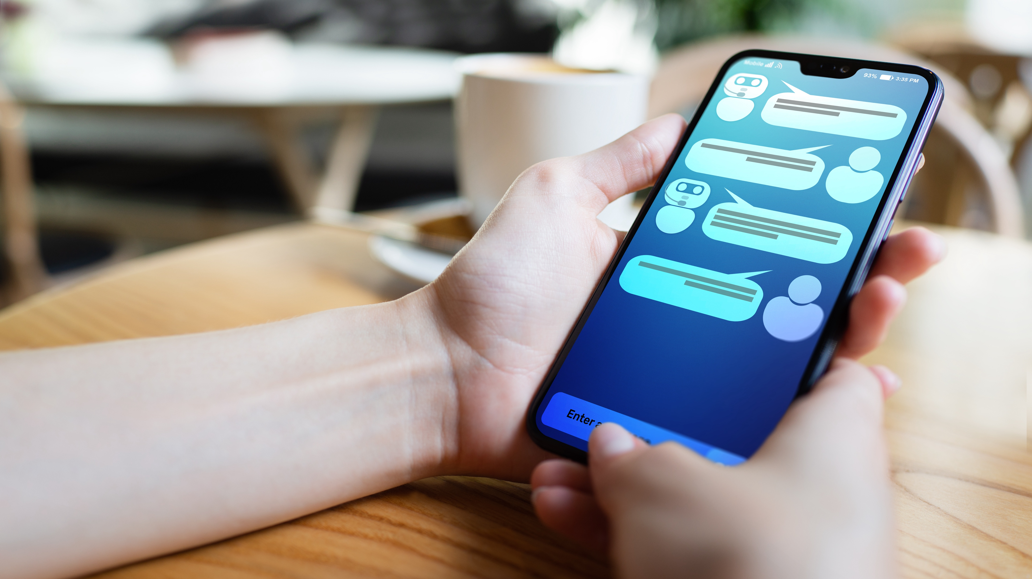
Becoming
Cognifying
Flowing
Screening
Accessing
Sharing
Filtering
Remixing
Interacting
Tracking
Questioning
Beginning
Questioning
Vision: good questions +valuable than good answers
Reality: generative AI, search engines, ⚠️ why? (humans)
Blockers: interactions need+ dialog and context
Q&A dialogs with objects/places?
🤔

Slide 15

Becoming
Cognifying
Flowing
Screening
Accessing
Sharing
Filtering
Remixing
Interacting
Tracking
Questioning
Beginning
Beginning
Vision: we’ll connect all humans and machines globally
Reality: internet, ⚠️ ambient computing, metaverse
Blockers: dependent on the previous forces

Slide 16
About me

Slide 17
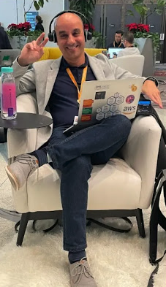

About me
Jorge Fonseca (he/him)
Senior Solutions Architect Amazon Web Services
linkedin.com/in/jorgefonseca

Slide 18
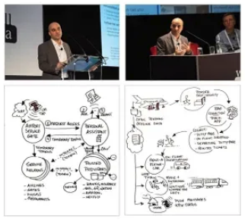
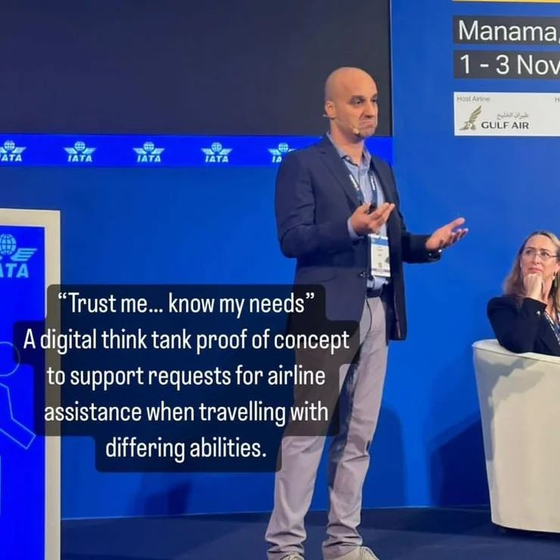
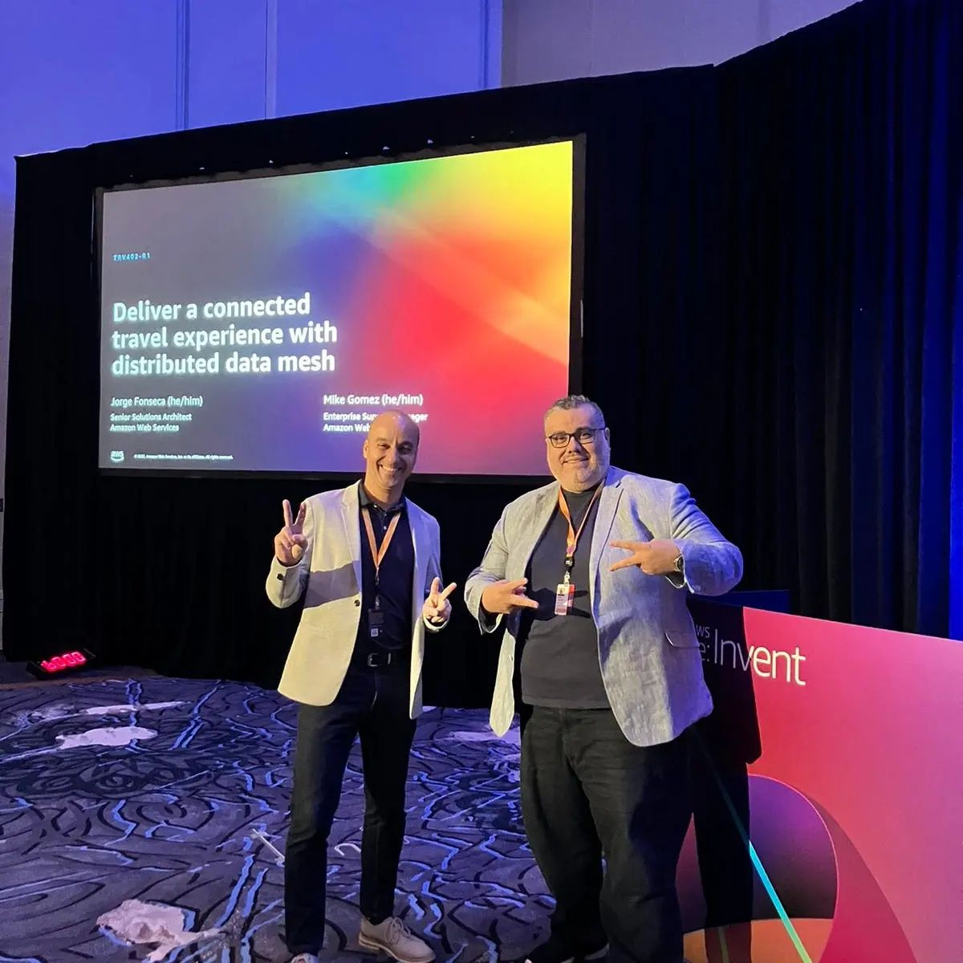
About the past
2018 @ London, UK Enterprise Cloud Comp. conf.
The future of customer experience in commercial aviation
2022 @ Manama, Bahrain World Passenger Symposium
IATA Digital Think Tank Trust me, know my needs W3C DIDs, VCs, DIDcomm
2022 @ Las Vegas, USA AWS re:Invent
Deliver a connected travel experience with distributed data mesh

Slide 19
About the future
Share with trust
Domain trust framework Decentralized backbone
Remix user screens
UI primitive parts Session dialogs
Cognify everything
One tap interactions One tap to connect

Slide 20
Sharing
• Trusting
• Securing
• Paying
Screening
• Interacting
• Forgetting
Cognifying
• Connecting
• Animating
Accessing
Sharing
👥 Domain
📜 schemas
🗄️ Vault
0
bind
1
credentials
C
disclose
2
👥 Domain
🏛️ Authority
🧑‍🦰 Wallet: App
share?
A
credentials
B
0
D
{info}
👥 Domain
🔎 Consumer
📜 schemas

Slide 21
Sharing
• Trusting
• Securing
• Paying
Screening
• Interacting
• Forgetting
Cognifying
• Connecting
• Animating
Accessing
Trusting
😌 trusts
👥 Domain A
👥 Domain B
📜
📜 manifest
😌 trusts
😌 trusts
👥 Domain
👥 Domain
🗄️ Vault
📜
👂 Listeners
📜
🔎 Consumer
🌬️ fan-out
trust receiver with info? 🤔
🕸 Graphs
trust sender’s info? 🤔
_{ℹ️} user info

Slide 22
Sharing
• Trusting
• Securing
• Paying
Screening
• Interacting
• Forgetting
Cognifying
• Connecting
• Animating
Accessing
Securing
📚 DNS 2
🅰️ HTTPS webhook endpoints
where are the receiver’s endpoints? 🤔
👥 Domain 1
👥 Domain 2
🔐 DKIM public key
📚 DNS 1
signed by sender? 🤔
🔐 signed message

Slide 23
Sharing
• Trusting
• Securing
• Paying
Screening
• Interacting
• Forgetting
Cognifying
• Connecting
• Animating
Accessing
Paying
🧑‍🦰 User (buyer)
👥 Company (seller)
charge
_{👥 Domain}
🧑‍🦰 Wallet: App
1
💸 Seller
2
pay
4
paid!
🗄️ Vault
🗄️ Vault
💳 Payer
3
🏦 Collector
bind
collect
register
0
0

Slide 24
Sharing
• Trusting
• Securing
• Paying
Screening
• Interacting
• Forgetting
Cognifying
• Connecting
• Animating
Accessing
Screening
👥 Domain
1
✉️
🤗 Host
✉️ answer
💬 prompt
💬
👥 Domain
👥 Domain
wallets
binds
creds
🤵 Broker 1
🤵 Broker 2
👥 Domain
👥
📣 Notifier
📣
🧑‍🦰 Wallet: App
2
🧑‍🦰
📣 alert
📣

Slide 25
Sharing
• Trusting
• Securing
• Paying
Screening
• Interacting
• Forgetting
Cognifying
• Connecting
• Animating
Accessing
Interacting
check in
1
🧑‍🦰 Wallet: App
A
disclose
🤵 Broker
📣
3
👥 Domain
😃 session talker
👥 Domain
2
B
🤗 Host
💬 prompts 💬 sharing 💬 bindings 💬 credentials 💬 payments 💬 goodbye!
🗄️ Vault
sessions
disclosures
C
_{ℹ️} user info

Slide 26
Sharing
• Trusting
• Securing
• Paying
Screening
• Interacting
• Forgetting
Cognifying
• Connecting
• Animating
Accessing
Forgetting
🧑‍🦰 Wallet: App
1
4
check-in
check-in again
👥 Domain
sessions
🤵 Broker
check-in as X
check-in as Y
2
5
3
6
goodbye X
👥 Domain
goodbye Y
sessions
🤗 Host

Slide 27
Sharing
• Trusting
• Securing
• Paying
Screening
• Interacting
• Forgetting
Cognifying
• Connecting
• Animating
Accessing
Cognifying
📍Place
🤖 Thing
🌐 Web page
🔆 NFC QR
🔆 NFC QR
✨ QR
tap scan
tap scan
scan
🧑‍🦰 Wallet: App
🤵 Broker
📣
check-in
😃 talker
👥 Domain
🤗 Host

Slide 28
Sharing
• Trusting
• Securing
• Paying
Screening
• Interacting
• Forgetting
Cognifying
• Connecting
• Animating
Accessing
Connecting
connect
_{🏡 Home} 📶 Wi-Fi router
3
_{🤖 Thing}
_{📶 Wi-Fi direct}
connect
share
0
2
🧑‍🦰 Wallet: App
1
tap scan
🔆 NFC QR

Slide 29
Sharing
• Trusting
• Securing
• Paying
Screening
• Interacting
• Forgetting
Cognifying
• Connecting
• Animating
Accessing
Animating
B
3
👥 Domain
create
👥 Domain
store files
👥 Domain
🖨️ Printer
🤖 Things
📦 Storage
2
check-in
A
🧑‍🦰 Wallet: App
C
order 🔆 NFC QR
subscribe 📦 storage
1
tap scan
🤖 Thing
🔆 NFC QR

Slide 30
Sharing
• Trusting
• Securing
• Paying
Screening
• Interacting
• Forgetting
Cognifying
• Connecting
• Animating
Accessing
Assessing
A
B
👥 Domain
register
👥 Domain
share?
👥 Domain
🖐️ Palmist
🆔 Biometric
🃏 Issuer
🖐️ scan palm
🛂 show passport
🔑 issue credential
issue
C
🧑‍🦰 Wallet: App
🔑 store credential
2
print
D
scan palm
scan QR
👥 Domain
1
📄 Printed
🔎 Consumer
✨ QR Credential

Slide 31


Sharing
• Trusting
• Securing
• Paying
Screening
• Interacting
• Forgetting
Cognifying
• Connecting
• Animating
Accessing
API definitions
Actors’ specifications Sequence diagrams Suggested AWS architectures
Test bench
Real-life examples Business ideas Data sharing schemas
https://tinyurl.com/dtfw-api
https://tinyurl.com/dtfw-tests

Slide 32
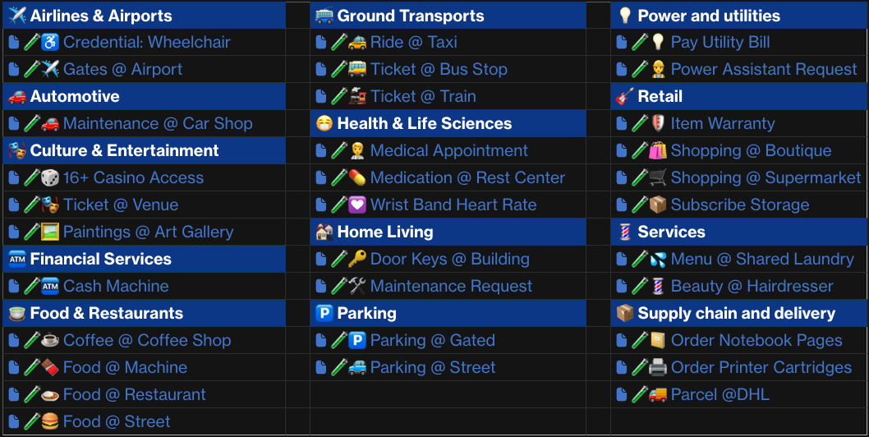
🧑‍🔬 Test bench
API definitions
Test bench

Slide 33
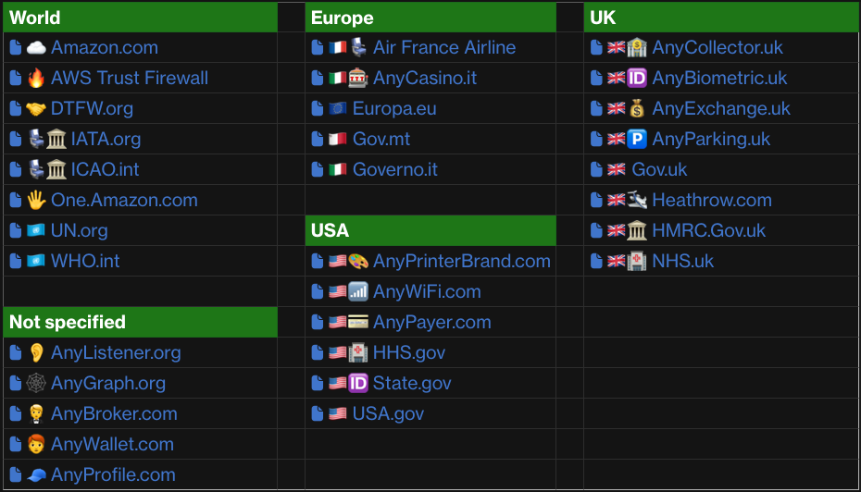
📜 Manifests
API definitions
Test bench

Slide 34
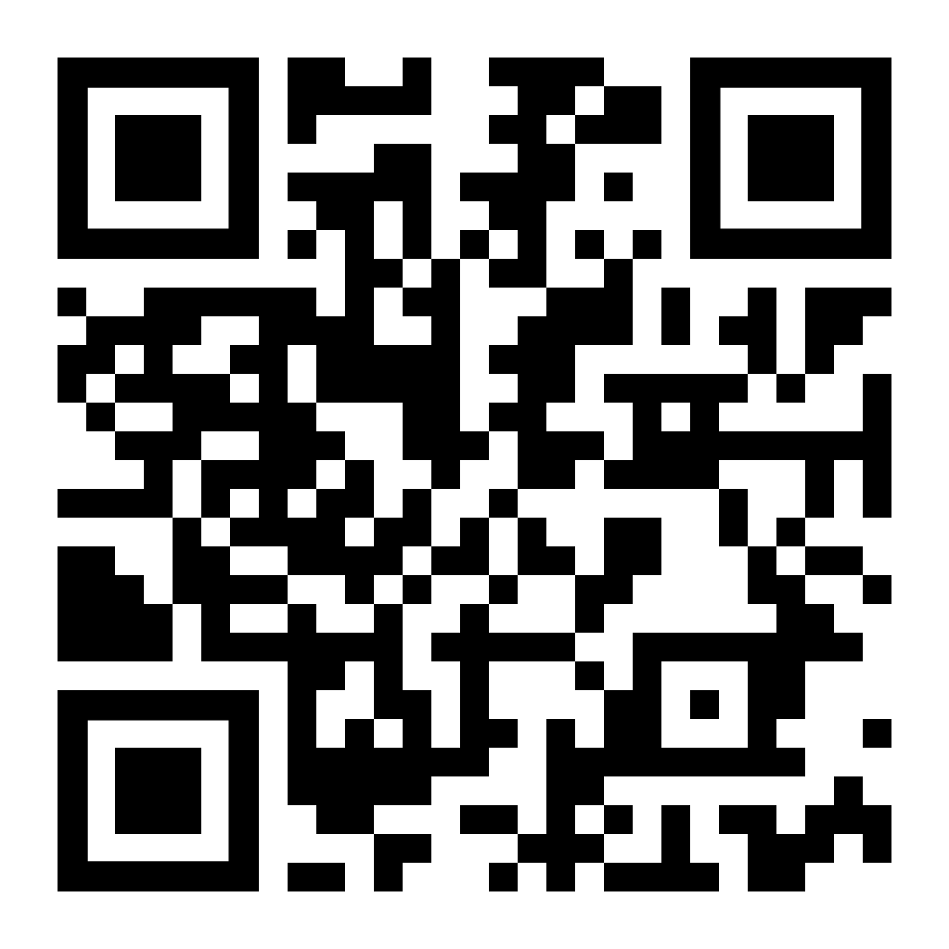
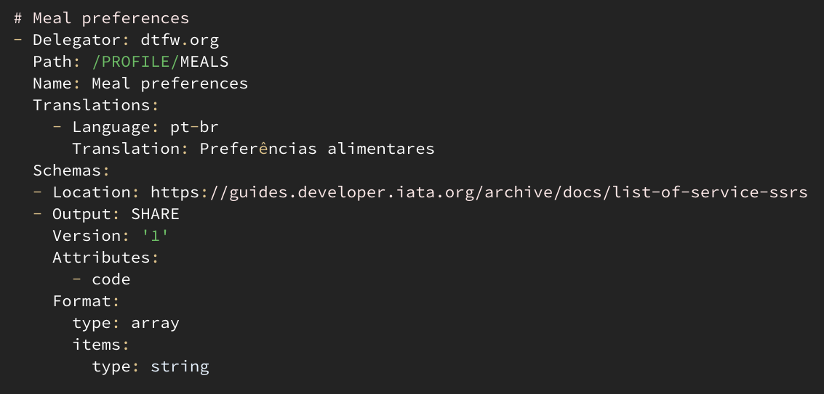
🤝 DTFW.org schemas
🏦 Bank 🤵 Broker 💰 Exchange 🤗 Host 🖐️ Palm 💳 Pay 🧢 Profile 📦 Storage 📶 Wi-Fi
🧩 /PROFILE
🧩 //DELIVERY
🧩 //BILLING
🧩 //EMERGENCY
🧩 //ALLERGIES
🧩 //PHONE
🧩 //BOOKING
🧩 //MEALS
🧩 //SOCIAL/NAME
🧩 //SOCIAL/FRIENDLY
🧩 //PARKING
🧩 //TRAVEL/GROUP
🧩 //TRAVEL/SEAT
🧩 //TRAVEL/TAXI
🧩 //TRAVEL/PLACE
DTFW.org schemas

Slide 35
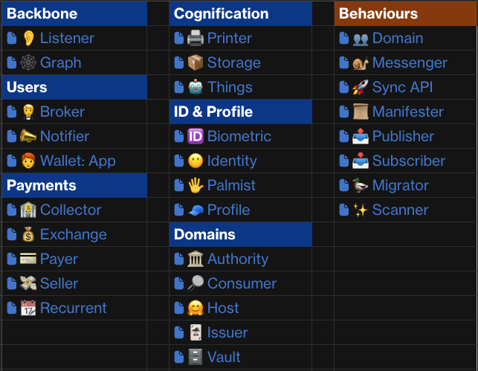
API definitions
API definitions
Test bench

Slide 36
API definitions
👉 Responsibilities 🖥️ Screens ⚙️ Sequence flows 🗺️ Architectures 😃 Talkers 🧠 Definitions 🪣 Persistence 🅰️ API methods - 🚀 Synchronous
- 🐌 Async
API definitions
Test bench

Slide 37
How many organizations did you see in the video?

Slide 38

Learn more
AWS Travel and Hospitality https://aws.amazon.com/travel-and-hospitality/

Slide 39
Jorge Fonseca (he/him)
linkedin.com/in/jorgefonseca

